Slide 1
Sai Packers & Movers
End-to-End Docker Deployment on AWS EC2
DOCKER

Slide 2
Part | Meaning
sudo | Runs the command with administrator (root) privileges. Installing software requires admin permissions.
dnf | The package manager used by Amazon Linux 2023 to install, update, and remove software.
install | Tells dnf to install a package.
docker | The package name to install.
-y | Automatically answers Yes to installation prompts.

Slide 3
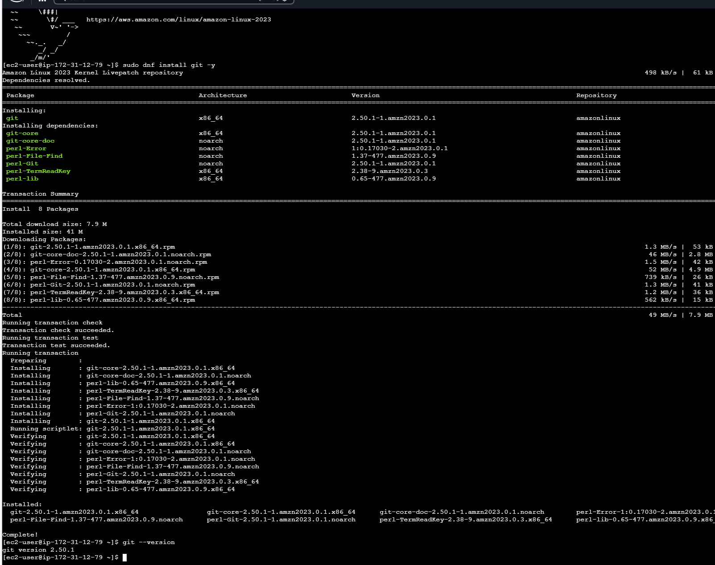
Step:1 Created EC2 installed Git and verified the verison sudo dnf install git –y To check git version git --version

Slide 4
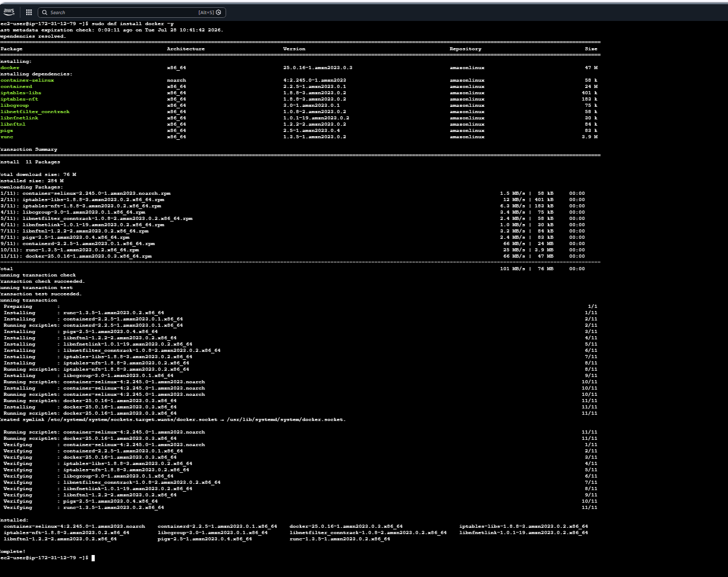
Step: 2
Install Docker Engine on the EC2 instance so we can build Docker images and run Docker containers. Purpose This command installs Docker Engine on the EC2 instance.
sudo dnf install docker -y

Slide 5
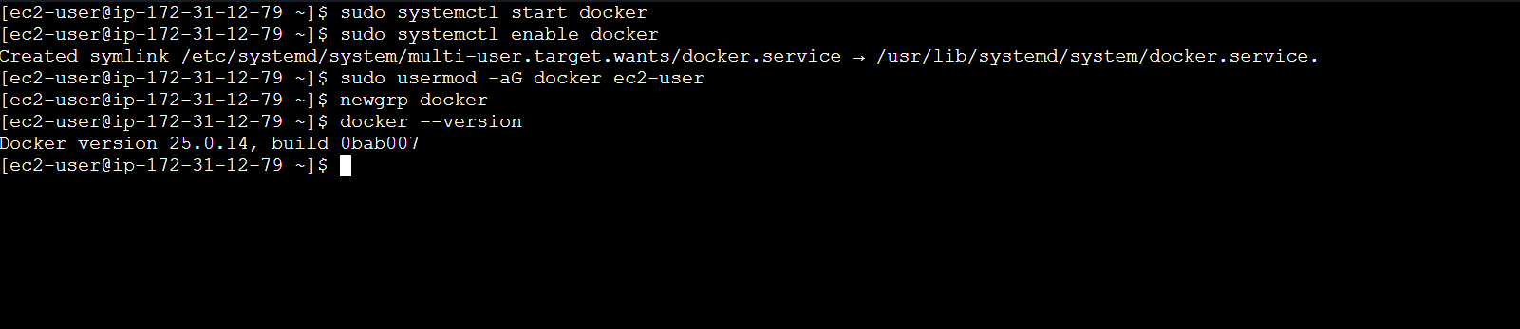
Step: 3 Starts the Docker service.
Installing Docker doesn't automatically start it. This command launches the Docker service so it can accept Docker commands.
sudo systemctl start docker
Step: 4 Without this command, Docker would stop after a reboot and you'd have to start it manually each time
sudo systemctl enable docker
Step: 5 Add the ec2-user to the Docker group so it can use Docker without typing sudo every time.
sudo usermod -aG docker ec2-user
Step: 6 After adding the user to the Docker group, your current login session doesn't know about the change yet. refreshes your current terminal so the new group membership takes effect immediately. newgrp docker Otherwise, you would need to: Disconnect from the EC2 instance. Connect again

Slide 6
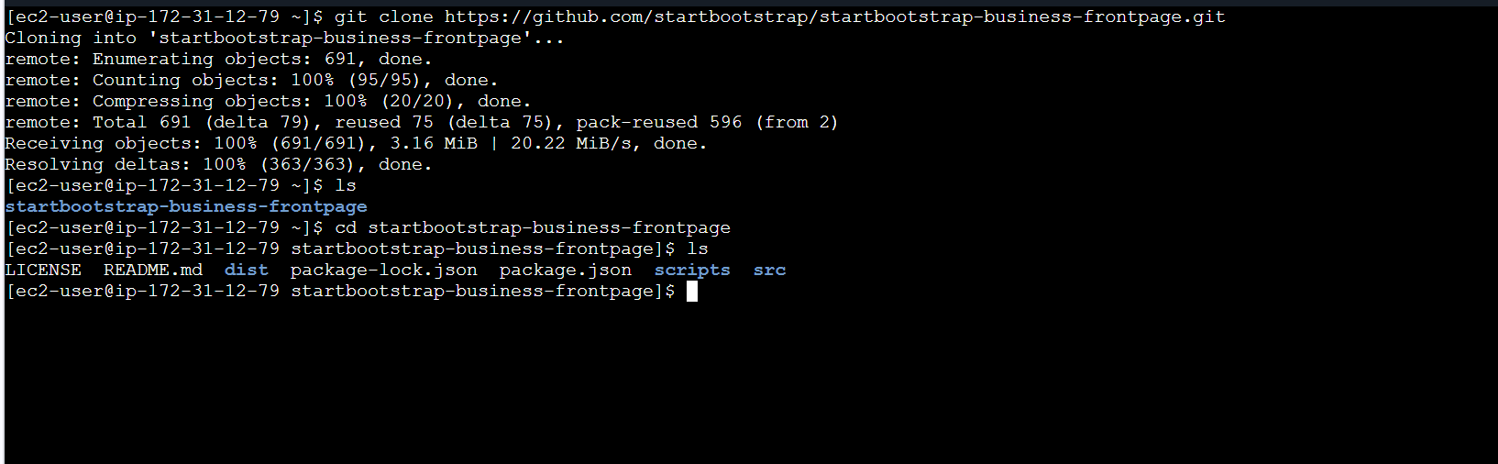
Step: 7 Downloaded the application's source code from GitHub to the EC2 instance. git clone https://github.com/Iamthesaikumar/Source-Code.git

Slide 7
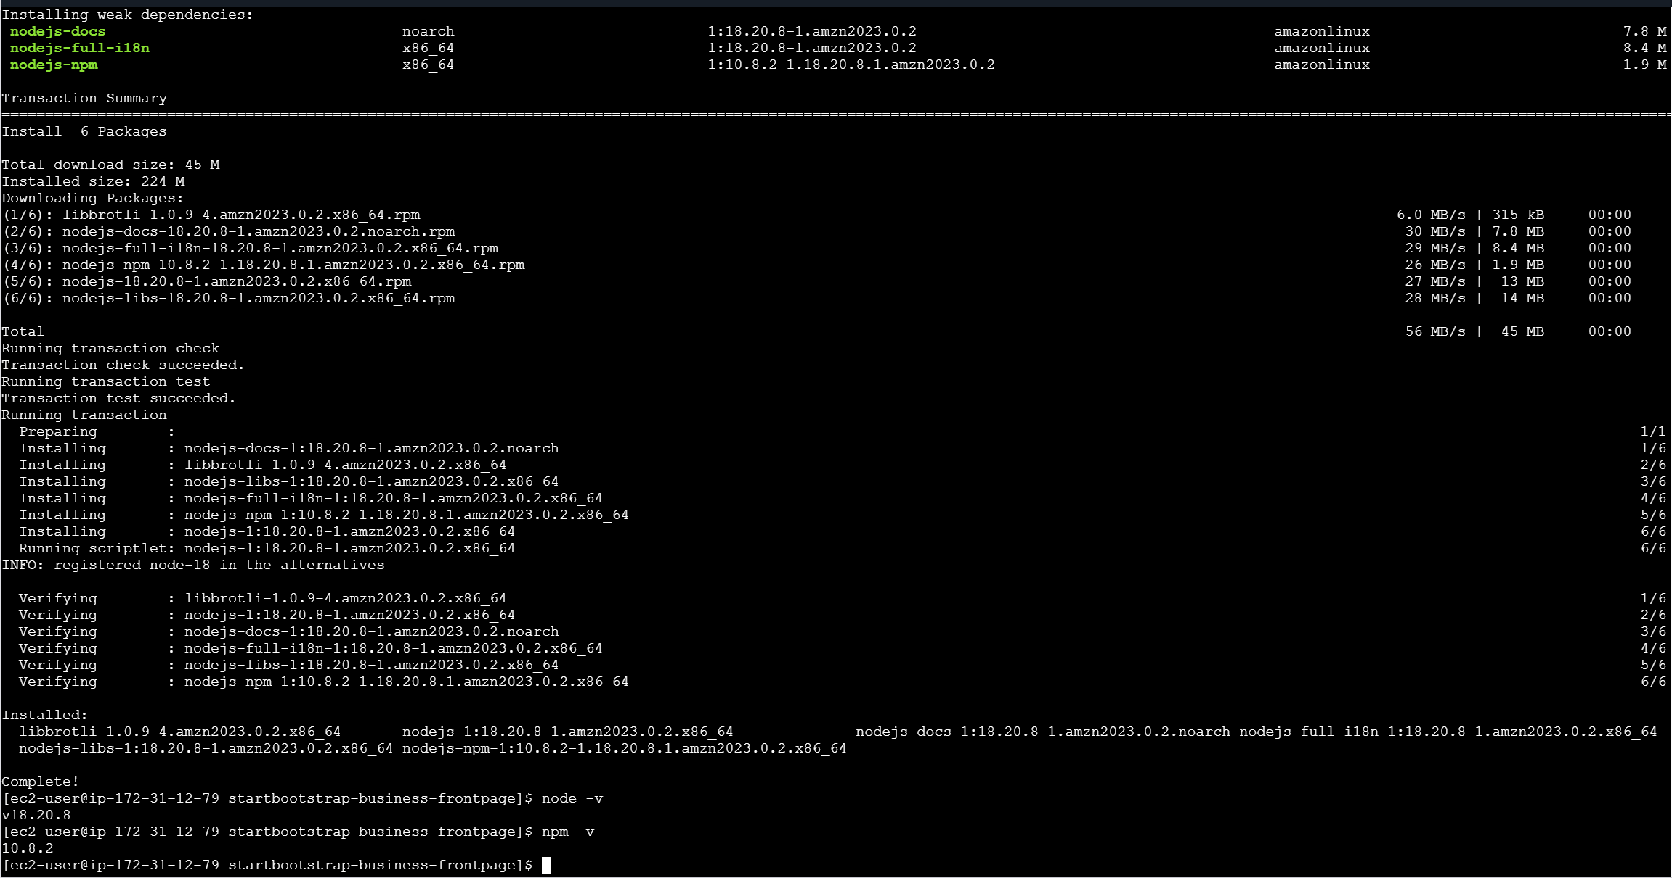
Step: 8 The application is developed using Node.js, so I installed the Node.js runtime on the EC2 instance to execute the application. Sudo dnf install Nodejs -y

Slide 8
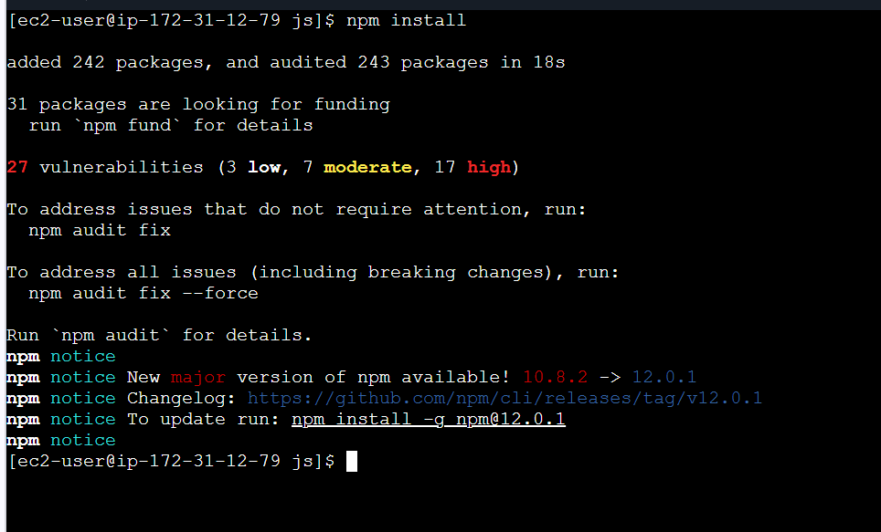
Step: 9
npm install reads the package.json file and downloads all the required libraries (dependencies) mentioned in it.
npm install

Slide 9
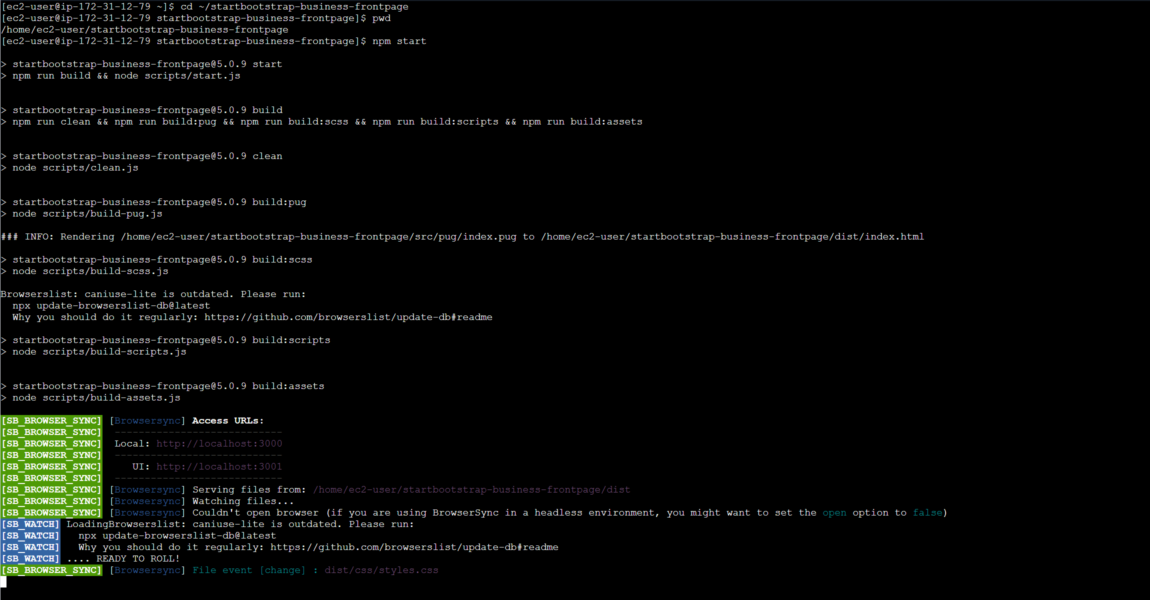
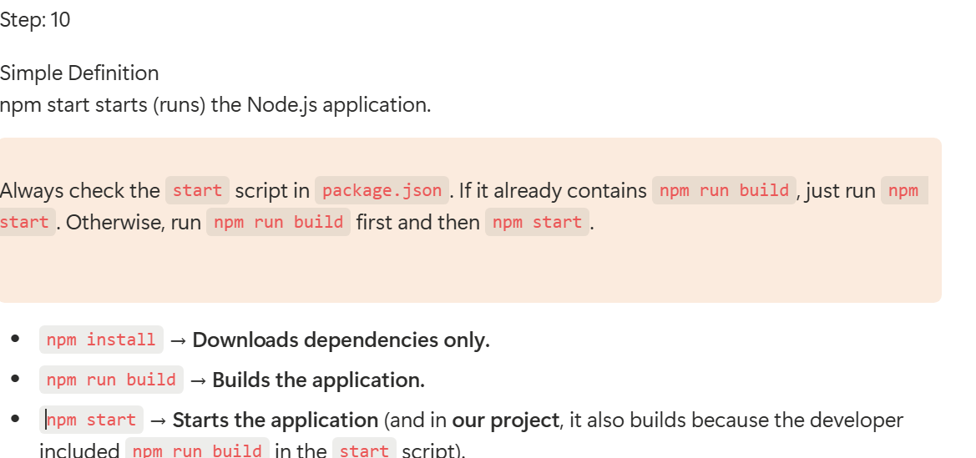

Slide 10
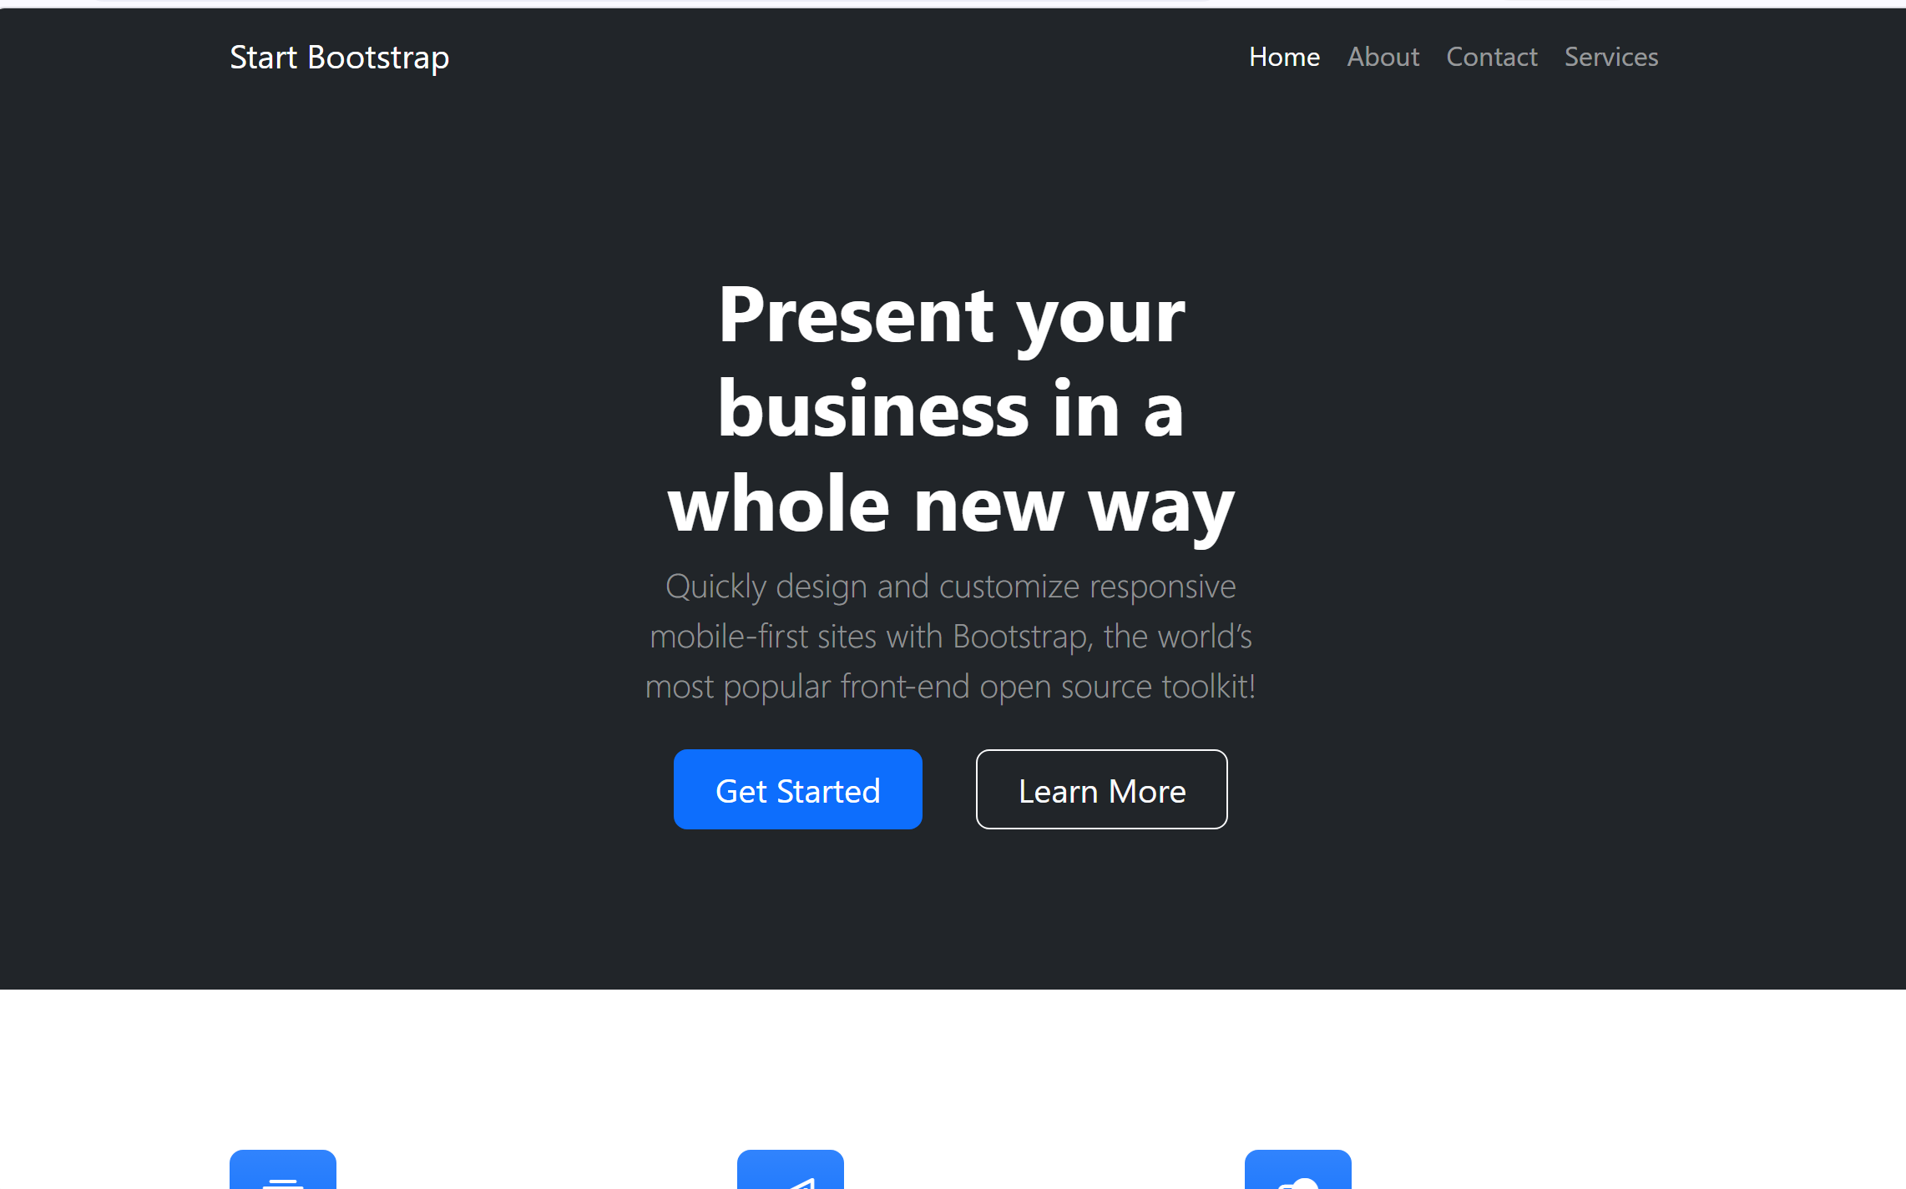
Step: 11 After running npm start, if the application starts successfully, we should access it from the browser using the application's IP address and the port number on which it is running. http://18.119.137.91:3000

Slide 11
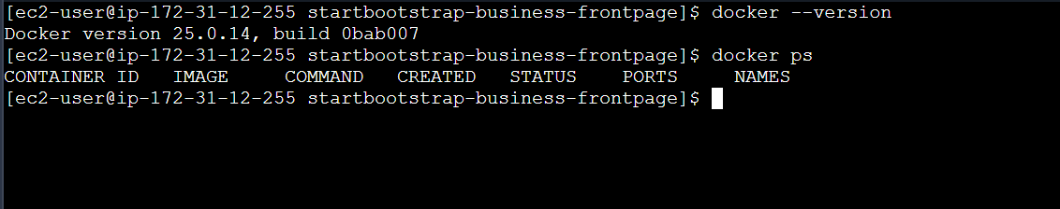
Step: 12 Check the docker version docker --version
docker ps is used to view the running Docker containers. Applies the new Docker group permissions without logging out and logging back in newgrp docker

Slide 12
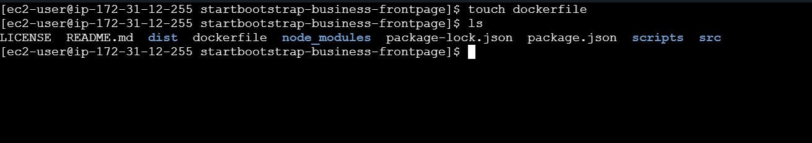
Step: 13 This creates an empty file named: touch dockerfile and verify ls

Slide 13
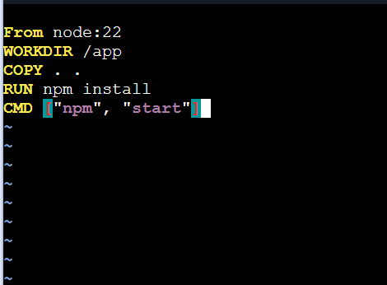
Step: 14
Save the commands and build the docker file
FROM node:22 WORKDIR /app COPY . . RUN npm install EXPOSE 3000 CMD ["npm", "start"]

Slide 14
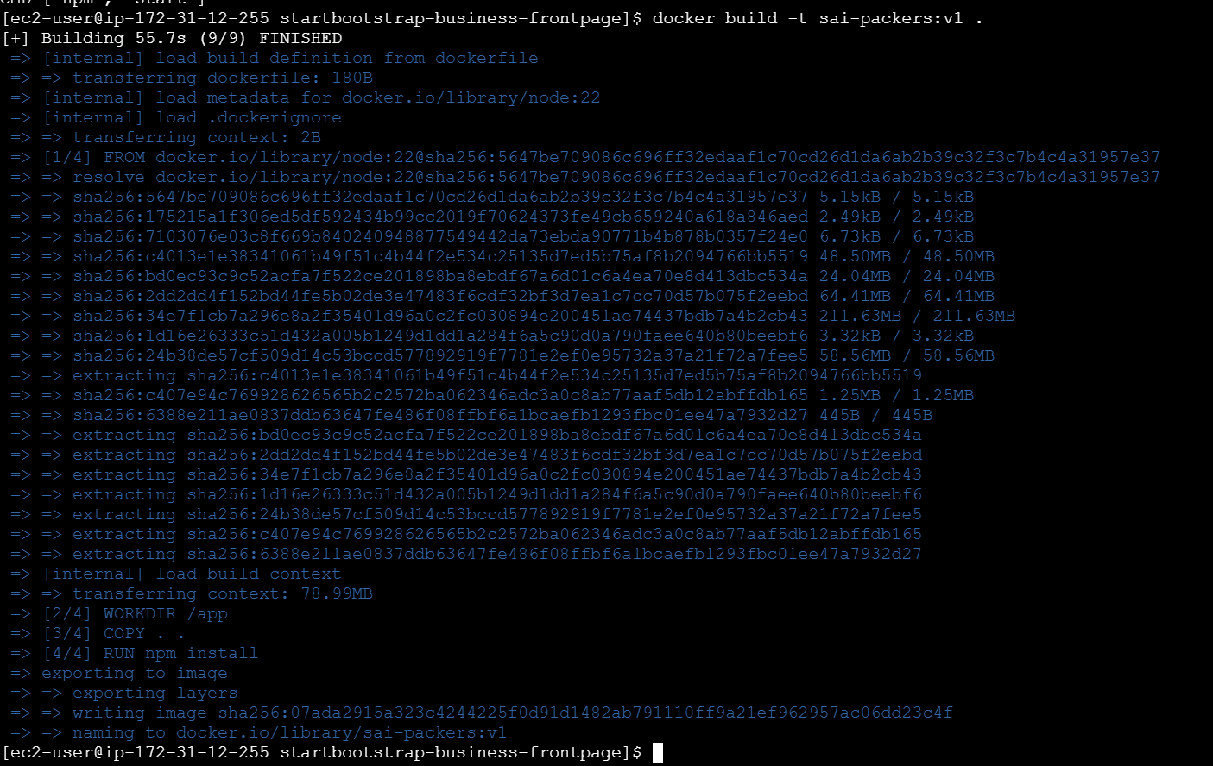
Step: 15 Build the docker file docker build -t sai-packers:v1.

Slide 15
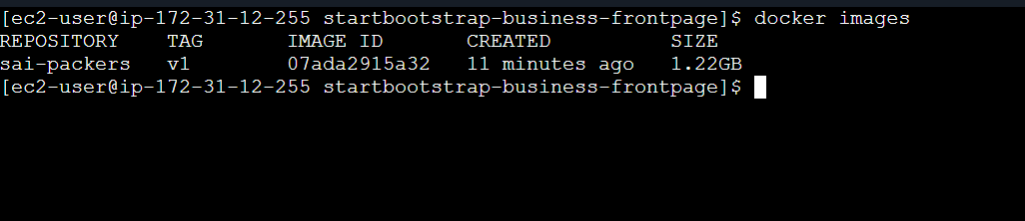
Step: 16 Verify the image docker images

Slide 16
Step: 17 This command creates a Container from the Image.
docker run -d -p 3000:3000 --name sai-container sai-packers:v1
docker run -d -p 3000:3000 --name sai-container sai-packers:v1 creates and starts a Docker container named sai-container from the sai-packers:v1 image, runs it in the background (-d), maps EC2 port 3000 to container port 3000 (-p 3000:3000), and makes the application accessible through port 3000.
A Container ID is a unique identifier automatically assigned by Docker to every container

Slide 17
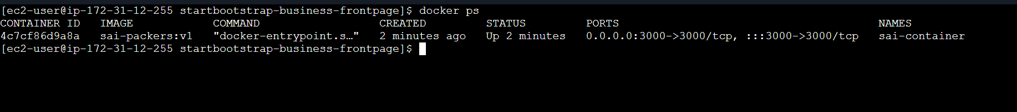
Step: 18
docker ps displays all currently running Docker containers. docker ps

Slide 18
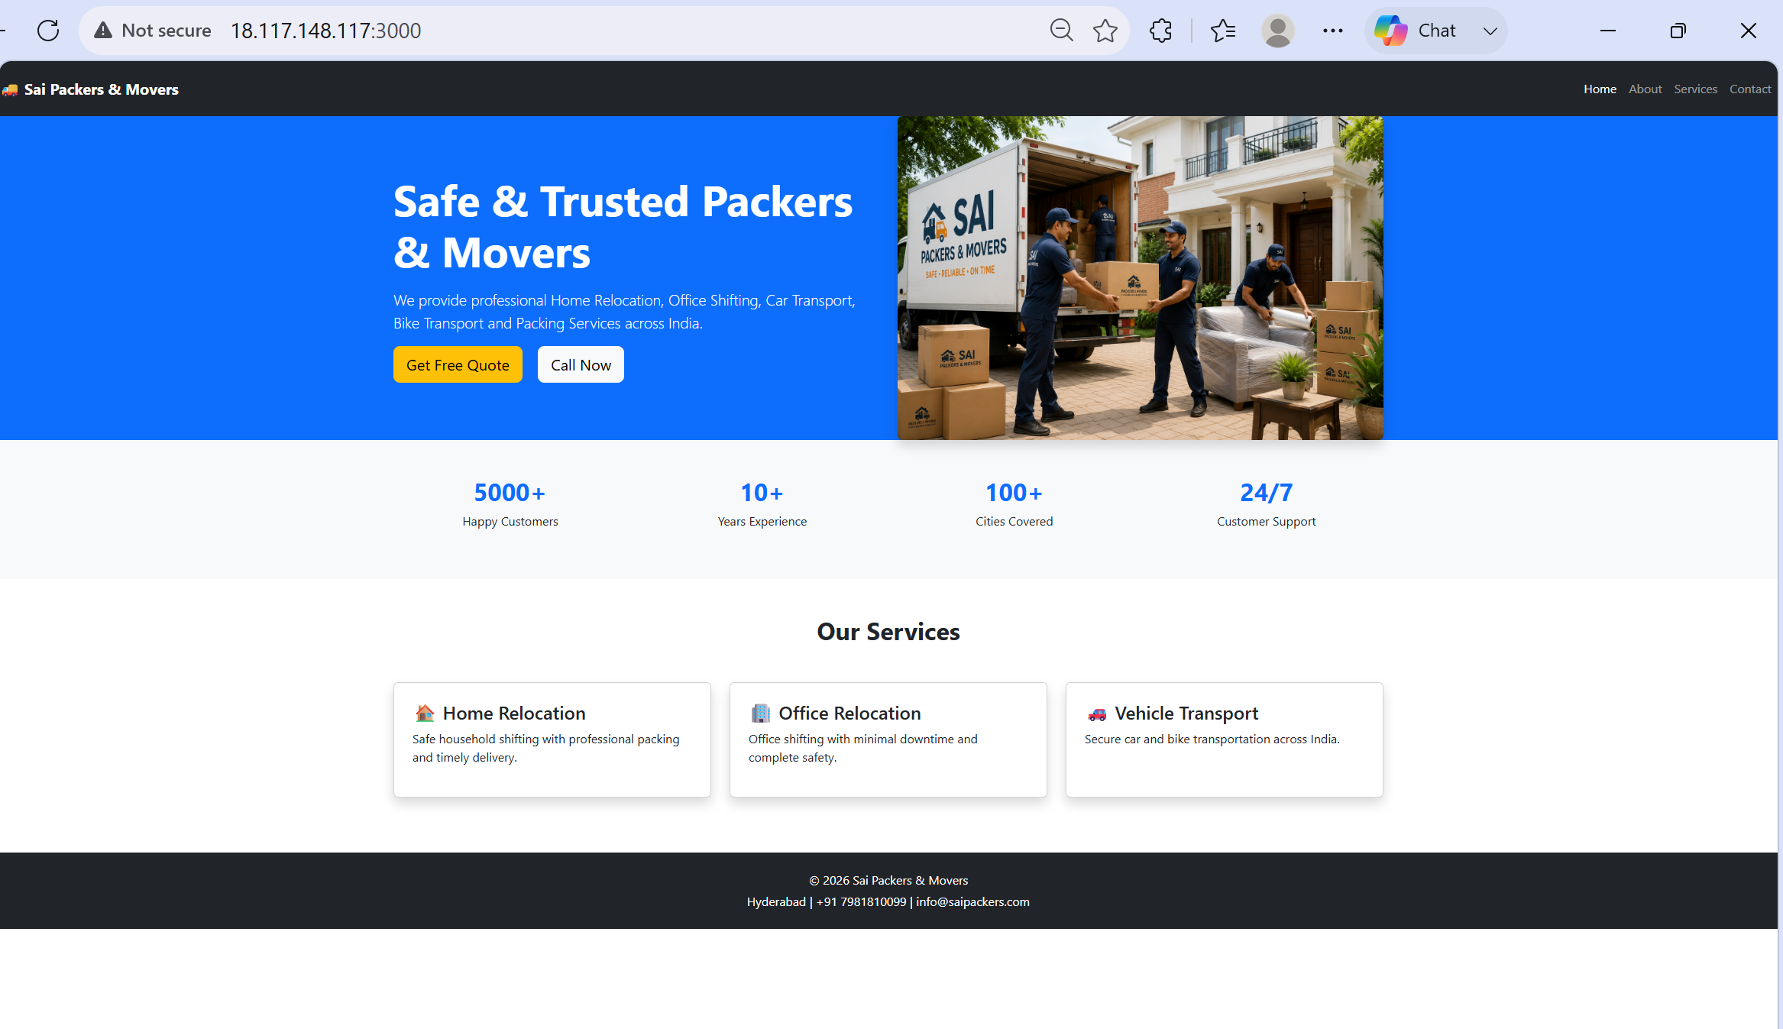
Step 19:
Able to access it from the browser

Slide 19
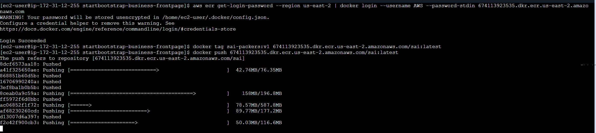
Step: 20 Push the image to ECR by running below commands 1. Authenticate Docker with Amazon ECR aws ecr get-login-password --region us-east-2 | docker login --username AWS --password-stdin 674113923535.dkr.ecr.us-east-2.amazonaws.com 2. Tag the Docker Image docker tag sai-packers:v1 674113923535.dkr.ecr.us-east-2.amazonaws.com/sai:latest 3. Push the Docker Image to Amazon ECR docker push 674113923535.dkr.ecr.us-east-2.amazonaws.com/sai:latest

Slide 20
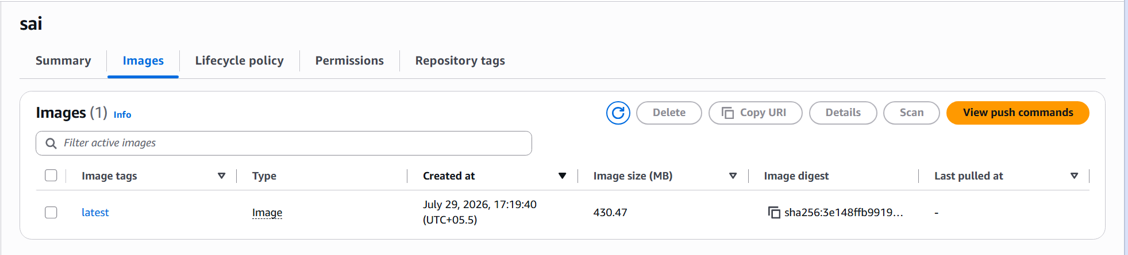
Step: 21 Verify in ECR

